Slide 1
Build a Strong MERN Foundation
Notes:
Trainer Notes:
This slide is self-explanatory, trainer notes not required.

Slide 2
Planning Projects with Agile
Notes:
Trainer Notes:
This slide is self explanatory, no trainer notes are required.

Slide 3
A Day in the Life of a MERN Stack Developer
John has decided to choose Agile methodology for his MERN stack projects.
To complete his project, he must learn the Agile methodologies that comprise a series of frameworks and principles and focus on delivering quality and value to the client and building a great team that is flexible and cohesive.
To achieve the above, he will learn a few concepts in this lesson that can help him to find a solution for the scenario.
Notes:
Trainer Notes:
This slide is self explanatory, no trainer notes are required.

Slide 4

Describe Agile methodology
Comprehend Agile testing methodology
Classify Waterfall and Agile approaches
Describe Scrum roles, practices, and estimation
Notes:
Trainer Notes:
This slide is self explanatory, no trainer notes are required.

Slide 5
Introduction to Agile
Notes:
Trainer Notes:
This slide is self explanatory, no trainer notes are required.

Slide 6
Before Agile
The waterfall model divides project operations into sequential stages that are linearly passed down from one another, each of which is characterized by a specialization of duties and is dependent on the outputs of the previous phase.
Requirements
Design
Implementation
Verification and Testing
Deployment and maintenance
Notes:
Trainer Notes:
This slide is self explanatory, no trainer notes are required.

Slide 7


Agile Methodology
Agile methodology is a practice that encourages continuous development and testing throughout the project's software development life cycle.
Both development and testing operations are concurrent under the Agile style of software testing.
Notes:
As agile methodology is used widely in most of the companies as their practice.
Agile methodology is a practice that encourages continuous development and testing throughout the project's software development lifecycle.
Both development and testing operations are concurrent under the Agile style of software testing.

Slide 8
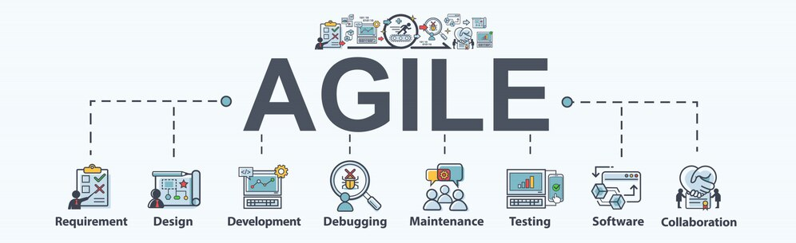
Agile Methodology
The methodology process includes:
Source link: https://www.exaosis.com/Pages/SoftwareTestingQA/AgileTesting
Notes:
Let us read out what are main process followed in Agile Methodology for Automation Testing process.

Slide 9

Agile Testing Methodology
Agile testing operates concurrently with development and incorporates testing tasks into the software development process.
As a result, faults can be found earlier, and resources can be used more effectively.
The goal of agile automation testing is to improve the effectiveness and efficiency of the software development process while maintaining quality, time, and resource consumption.
Notes:
Now. let us understand what is Agile testing methodology ?
Automation that is Agile Testing in software development is a test automation methodology used in agile processes.
The goal of agile automation testing is to improve the effectiveness and efficiency of the software development process while maintaining quality, time, and resource consumption.

Slide 10
Agile Manifesto
According to the Agile Manifesto, there are four fundamental principles of Agile software development:
People and their interactions over procedures and tools
A functional program above thorough documentation
A collaboration with the client over contract negotiations
Responding to change over following a plan
Notes:
Now a question might arise, why is Agile used widely and followed accordingly.
It is because of Agile manifesto. The Agile Manifesto is a document that identifies key values and principles that its creator believe software developers should use to guide their work.
According to the Agile Manifesto, there are four fundamental principles of Agile software development:
Over procedures and equipment, it is people and their interactions
A functional program above thorough documentation
A collaboration with the client during contract negotiations
Following a plan as opposed to reacting to change

Slide 11
Agile Methodology
Agile project management is based on the idea that a project can be improved continually throughout its life cycle with changes being made swiftly and appropriately.
Agile project management techniques involve:
Active communication
2. Iterative development
Notes:
What does the Agile project management technique involve?
It is a method for project management that involves active communication and iterative development.
Agile project management is based on the idea that a project can be improved upon continually throughout its life cycle with changes being made swiftly and appropriately.
In the next slide you’ll know why it is used widely.

Slide 12
Agile Methodology
Agile project management is among the most widely used methods because of its:
Emphasis on client feedback
Agile project management
Adaptability
Flexibility
Notes:
Agile project management is among the most widely used methods because of its adaptability, flexibility, and emphasis on client feedback,

Slide 13
Differences Between Waterfall and Agile Approaches
Agile | Waterfall
The project development life cycle is split into sprints. | The software development process is divided into segments.
It uses an iterative and flexible process. | Waterfall is a rigid and sequential process.
Agile technique is well known for its adaptability. | Waterfall is a structured software development process; thus, it can be extremely rigid at times.
Notes:
There are different types of Software development approaches to follow.
Let us compare the most followed method and why Agile is the best.
Now let us analyze the differences between the Agile and Waterfall approach

Slide 14
Differences Between Waterfall and Agile Approaches
Agile | Waterfall
Agile can be thought of as a collection of many projects. | The development of software is done as one project.
Agile is an adaptable strategy that allows for changes in project development requirements during the development as well. | Once the project development begins, there is no way to change the specifications.
Notes:
(After reading out the differences )
Now differences between the Agile and Waterfall approach is understood, hope everyone can analyze why Agile is efficient and effective way for a Project management.

Slide 15
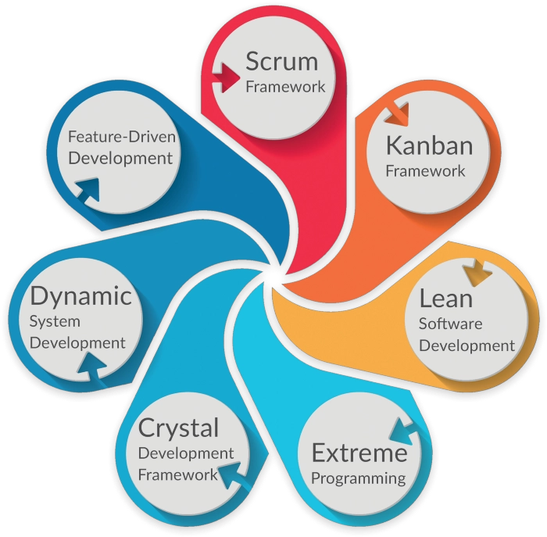
Approaches of Agile
The different approaches of Agile are:
source: https://ifulltest.github.io/en/posts/different-agile-methodology/
Notes:
Added slide to get better flow into the topic of scrum

Slide 16
Scrum
Notes:
Trainer Notes:
This slide is self explanatory, no trainer notes are required.

Slide 17


Scrum
Scrum is a methodology for addressing complex adaptive challenges while producing high-value solutions in a productive and creative manner.
Scrum is neither a process nor a technique for creating goods. It provides a framework within which multiple processes and techniques can be used.
Notes:
Scrum is the type of Agile framework. Let us understand how Scrum is efficient
Scrum is a methodology for addressing complex adaptive challenges while producing high-value solutions in a productive and creative manner.
Scrum is neither a process or a technique for creating goods; rather, it provides a framework within which multiple processes and techniques can be used.

Slide 18

Scrum
Scrum displays the relative effectiveness of user’s product management and development techniques, enabling organizations to improve.
Notes:
To understand the efficiency of Scrum,
Scrum displays the relative effectiveness of your product management and development techniques, enabling organizations to improve.

Slide 19



Scrum Roles
The Scrum team consists of three roles :
A Scrum Master
A Product Owner
The Team
Notes:
As we have understood about Scrum, Lets comprehend the process of Scrum
So, the Scrum Team consists of three roles, namely a Scrum Master, a Product Owner, and the Team.

Slide 20


Scrum Master
A Scrum Master ensures that a scrum team maintains scrum values that are achievable. This implies that they keep the team on track, schedule and lead meetings, and help resolve any roadblocks.
Scrum masters may potentially play a bigger role inside an organization, assisting in the implementation of scrum principles.
Notes:
Now, let us describe the terms as we read in the previous slide:
A Scrum Master oversees ensuring that a Scrum team maintains Scrum values as much as achievable. This implies they keep the team on track, schedule and lead meetings, and help the team resolve any roadblocks.
Scrum Masters may potentially play a bigger role inside an organization, assisting in the implementation of Scrum principles.

Slide 21
Scrum Master
A scrum master will have the following responsibilities:
Get rid of roadblocks to productivity
2. Organize sprint planning sessions
3. Conduct retrospective reviews
4. Conduct daily Scrum meetings
5. Communicate with stakeholders
Notes:
A Scrum Master will have the following responsibilities:
Conduct daily Scrum meetings
Organize sprint planning sessions.
Conduct "retrospective" reviews to determine what worked well and what could be improved for the next sprint.
Getting rid of roadblocks to productivity
Communicate with stakeholders outside the team to overcome difficulties that the team faces.

Slide 22



Product Owner
A product owner ensures that the scrum team is aligned with the broader product goals to which they are contributing.
They are aware of the product's business requirements, such as client expectations and market trends.
Notes:
Now let us understand the role of Product Owner in the Scrum team
A product owner ensures that the Scrum team is aligned with the broader product goals to which they are contributing.
They are aware of the product's business requirements, such as client expectations and market trends.

Slide 23




Product Owner
The following are the duties that product owners have:
Increasing value of the work
Setting the team's product vision
Ensuring that the team is focused on meeting product requirements by communicating and assessing progress
Contacting the external stakeholders and communicating their needs to the team
Notes:
The following are the duties that product owners:
Increasing the value of the work that the Team does.
Setting the team's product vision.
Ensure that the team is focused on meeting product requirements by communicating and assessing progress.
External stakeholders should be contacted, and their needs should be communicated to the team.

Slide 24


The Team
The team is cross-functional and self-organizing. This implies that the team will include analysts, designers, developers, testers, and others as needed and appropriate for the project.
Notes:
Now, let us understand the role of The team in the Scrum:
The team is cross-functional and self-organizing. This implies that the team will include analysts, designers, developers, testers, and others as needed and appropriate for the project.

Slide 25

The Team
Cross-functional teams have all the skills needed to complete the task without relying on anyone outside the team, saving time and effort.
The team concept in scrum is designed to enhance flexibility, innovation, and productivity.
Notes:
Cross-functional teams have all the skills needed to complete the task without relying on anyone outside the team, saving time and effort.
The team concept in Scrum is designed to enhance flexibility, innovation, and productivity.

Slide 26




The Team
The team is tasked with the following:
Support sprint planning and target setting
Contribute knowledge to the programming, design, or improvement of products
Determine the best development strategies using data
Include testing products and prototypes, as well as other methods
Notes:
The team are tasked with the following:
Support with sprint planning and target setting.
Contribute your knowledge to the programming, design, or improvement of products.
Data may be used to determine the best development strategies.
Quality assurance includes testing products and prototypes, as well as other methods.

Slide 27
Scrum Practices
Notes:
Trainer Notes:
This slide is self explanatory, no trainer notes are required.

Slide 28


Scrum Practices
Whether it is a product owner, scrum master, or team member, there are some best practices that assist in increasing productivity and putting the team on the path to the completion of any projects.
Notes:
Lets us analyze what are the Scrum practices:
Whether you're a product owner, Scrum master, or team member, here are some best practices to assist you increase your productivity and put your team on the path to completion of any projects!

Slide 29
Scrum Practices
The practices include three ways:
Teamwork and meeting
Planning and estimation
Backlog management
Notes:
Let us comprehend the Scrum practices
The practices includes three ways:
Teamwork and meeting
Planning and estimation
Backlog management

Slide 30



Teamwork and Meetings
Create a product backlog with the help of stakeholders
Include all stakeholders in scrum meetings
Avoid reorganizing teams
Work on developing the team
Notes:
There are few practices that can be followed in Teamwork and Meetings
Create a Product Backlog with the help of stakeholders
Include all stakeholders in Scrum meetings
Avoid reorganizing teams
Work on developing your team

Slide 31
Scrum Estimation
Notes:
Trainer Notes:
This slide is self explanatory, no trainer notes are required.

Slide 32



Estimates and Planning
Keep stakeholders informed during the estimation process
Plan a new sprint only when the queue has enough items
Define the objectives
Schedule daily risk mitigation plan
Notes:
Estimates and planning
Keep stakeholders informed during the estimation process.
Plan a new sprint only when the queue has enough items.
Clearly define your objectives.
Schedule daily risk mitigation time.

Slide 33
Backlog management
Keep the sprint and product backlogs distinct
Use approaches for task prioritization
Work with a scrum board
Notes:
Backlog management
Keep the sprint and product backlogs distinct.
Use approaches for task prioritization.
Work with a Scrum board.

Slide 34
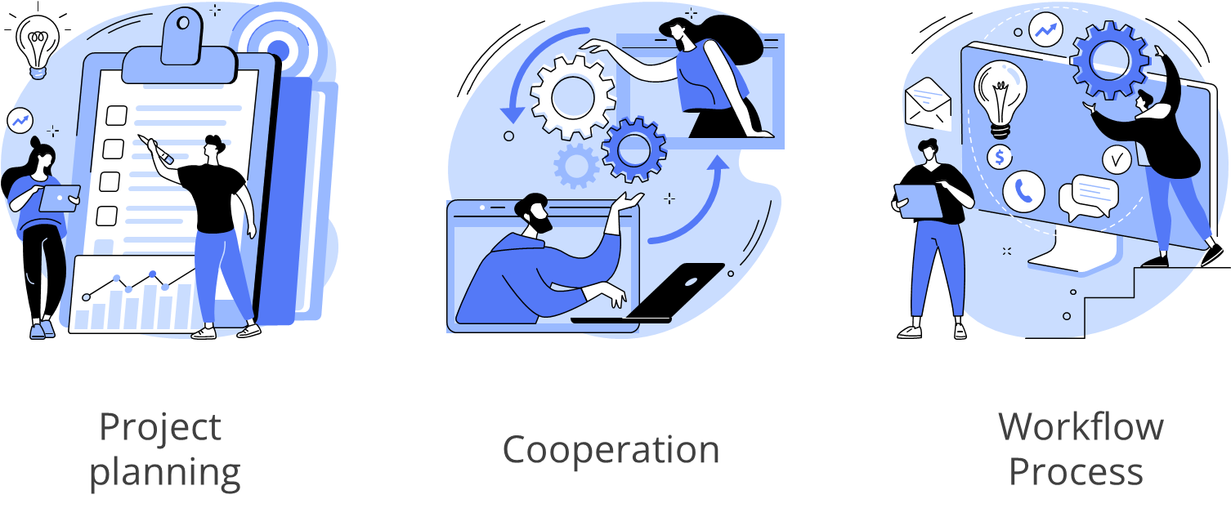
Scrum Estimation
Scrum estimates the difficulty of each user story. A specific scale is employed to evaluate the degree of difficulty.
Notes:
To know the results of the Scrum team efforts in the sprint we should estimate the work done
That is Scrum estimation: Scrum estimates the difficulty of each user story. A specific scale is employed to evaluate the degree of difficulty.

Slide 35
Scrum Estimation
In scrum estimation, a variety of scales are employed. Some examples are as follows:
Planning Poker
1
T-Shirt Sizes
2
Large or Uncertain or Small
3
The Bucket System
4
Dot Voting
5
Notes:
In Scrum Estimation, a variety of scales are employed. Some examples are as follows:
Planning Poker
T-Shirt Sizes
Large or Uncertain or Small
The Bucket System
Dot Voting

Slide 36
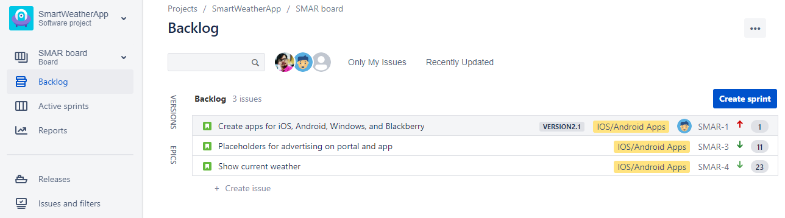
Product Backlog
Product backlog is an ordered list of tasks to be done in the product.
{
Product Backlog
It is a single source of requirements to be added to a product.
It is a living document.
Tasks are prioritized and ordered accordingly.
The product owner is responsible for the backlog.
Sprint 1……..n
Notes:
Trainer Notes:
Explain the importance of Product backlog.
Screenshot provided in the slides are actual images of JIRA Dashboard. Explain the flow of the same.
Explain the importance of Sprints and how it is scheduled.

Slide 37
User Stories
The purpose of a user story is to describe the task which will deliver a particular value to the customer.
User stories should include:
An identifier and a name
A description
An estimated value
An estimated effort
Associated risks, dependencies, and acceptance tests
Notes:
Trainer Notes:
Explain the importance of Index cards.
How index cards are used and who uses it.
Explain the structure of the index cards.
What is expected from the index cards and the user stories.

Slide 38
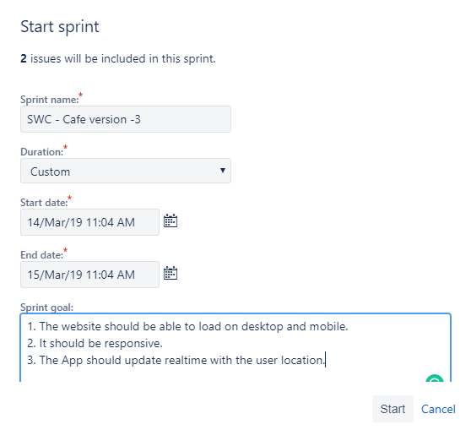
Sprint Backlog
The sprint backlog is a list of tasks identified by the Scrum team which must be completed within the estimated time, also known as a sprint. It is maintained by the development team.
Name of the sprint
Duration of the sprint
Start date of the sprint
Estimated end date of the sprint
Notes:
Trainer Notes:
Explain the importance of Sprint Backlog.
What is included in the Sprint backlog and how it helps in achieving the goals.
Explain the screenshot on Sprint particulars.

Slide 39
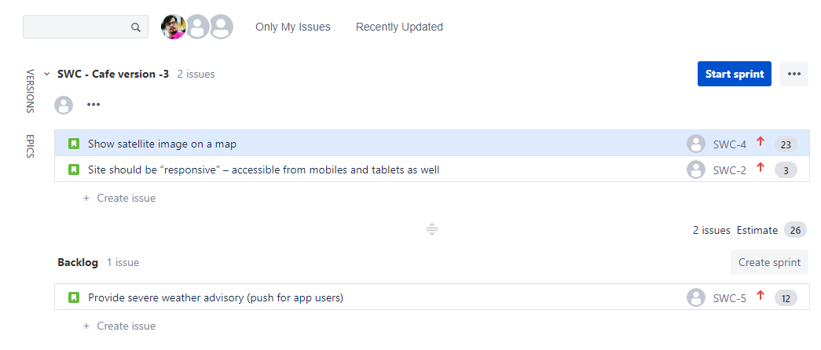
Sprint Backlog
Sprint backlog
Product backlog
Notes:
Trainer Notes:
Explain the screenshots with respect to the JIRA Dashboard.
Explain the Difference of Sprint and Product backlog.

Slide 40



Timeboxing
The goal of timeboxing is to define and limit the amount of time dedicated to a task.
Benefits:
Efficient development process
Less overheads
High velocity for teams
Notes:
Trainer Notes:
Explain the time-boxing approach in detail and its benefits.

Slide 41
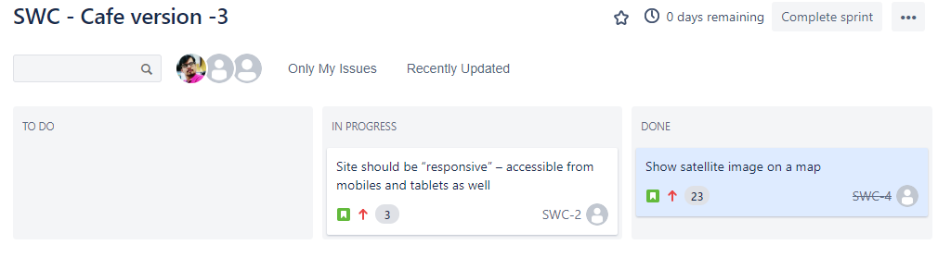
Definition of Done
A checklist of things that must be verified before an item or a story is marked as completed. It evolves as the Scrum team matures. It can be applied to:
A user story
A sprint
A release
A project
Task is Done
Notes:
Trainer Notes:
Explain the importance of Definition of Done
Explain how it is applied to User story, sprint, release and project.

Slide 42
Scrum Planning
Notes:
Trainer Notes:
This slide is self explanatory, no trainer notes are required.

Slide 43
Planning Layers and Product Roadmaps
Strategy
Portfolio
Product
Executives define and govern the execution of the strategic goals.
The product offerings are established considering the vision of the executives.
Each Scrum team sets a product vision and outlines the roadmap for the projects.
Notes:
Trainer Notes:
Explain how the product roadmap is planned.
How sprints are planned and executed.
Explain the importance of each stage.

Slide 44
Planning Layers and Product Roadmaps
Daily
Sprint
Release
The Scrum team meets every day for a status update and makes a plan-of-action for the next twenty-four hours.
The Scrum team determines the user stories that can be completed within the sprint.
The Scrum teams group product backlog items into smaller releases.
Notes:
Trainer Notes:
Explain how the product roadmap is planned.
How sprints are planned and executed.
Explain the importance of each stage.

Slide 45
Releases Supporting Product Roadmaps
A prioritized backlog of product features must match the product roadmap.
Release roadmap:
Release 2.0v
Example:
First version is available to all the registered members
Second version is available to premium members only
Third version is available to all the members
Release 1.6v
Release 1.0v
V 🡪 version
Notes:
Trainer Notes:
Explain how releases support product roadmaps
Explain the example by mapping it to any real-world scenario.

Slide 46
Releases Supporting Product Roadmaps
Release 1.0v
Release 1.6v
Release 2.0v
Sprint 2
Sprint 1
Story 1
Story 2
Story 3
Task 1
Task 2
Task 3
Task 4
Notes:
Trainer Notes:
Explain how releases are sub-categorized.
Explain how sprints, stories, and tasks are planned and added in the JIRA/project management tools.
Explain the benefit of this approach.

Slide 47
Sprint Planning and Objectives
Scrum projects can be accomplished through:
Themes and epics
Releases
Sprints
User stories
Small Projects | Large Projects
Three to six sprints | More than six sprints
Six to twelve weeks | More than six months
Single team | Multiple teams
Story level: | Story level:
Sprint planning meeting is attended by the Scrum team which consists of:
Scrum master
Product owner
Development team
End users and executives (optional)
Release
Sprint
Business area
Theme or Epic
Features
Notes:
Trainer Notes:
Explain how the Scrum project is explained and categorized.
Explain how sprint planning are organized and who are the active participants.
Explain the variations in small and large projects as mentioned in the table.

Slide 48






Sprint Planning and Objectives
Each sprint planning is scheduled to last two hours for each week of the sprint’s duration.
2 Weeks
2 Weeks
Sprint 1
2 Weeks
Product Backlog
Sprint 2
Sprint 1
Notes:
Trainer Notes:
Explain the importance of Product backlog.
Explain the importance of Sprints and the variations in the stories in each section.
How sprints are organized and its classifications.

Slide 49
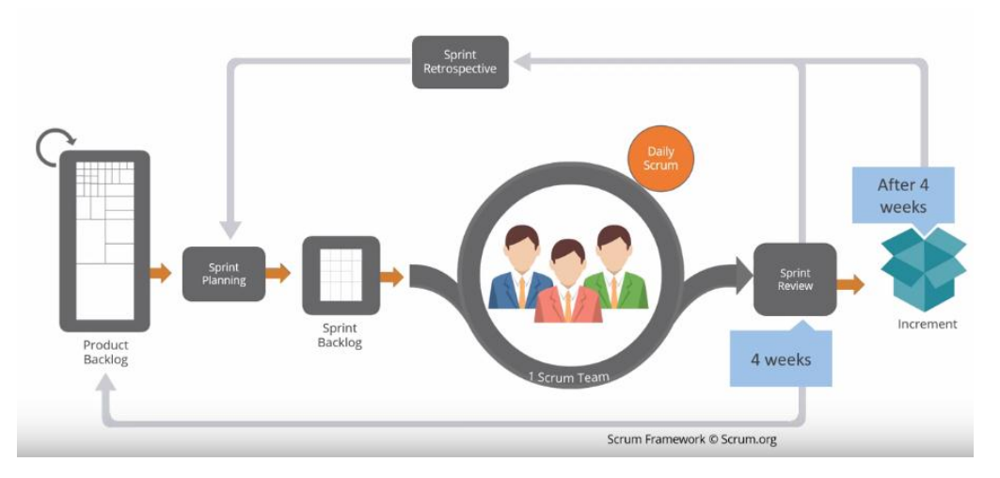
Sprint Planning Meeting
Inputs from stakeholders
Product owner prioritizes the product backlog
Release plan followed by sprint planning
Notes:
Trainer Notes:
Explain the step-by-step procedures in sprint planning meeting.
The 2nd diagram represents the workflow of Scrum, explain the workflow phase-by-phase in-detail.

Slide 50






Scrum of Scrums
Scrum of Scrums is a scaling mechanism.
The Scrum masters and developers need to deliver the Scrum of Scrums collaborative which is the Definition of Done. They meet and communicate to discuss:
The impediments
Progress
Cross-team coordination
Scrum of Scrums
Scrum Master
Scrum Master
Developers
Scrum Master
Notes:
Trainer Notes:
Explain the importance of Scrum of Scrums
Explain the role of the active members and their importance in the Scrum of Scrums

Slide 51
Scrum Events
Notes:
Trainer Notes:
This slide is self explanatory, no trainer notes are required.

Slide 52

Sprint Review Meeting
The Scrum Master should start scheduling the sprint review meeting.

Slide 53
Sprint Review Meeting
The Sprint review:
is a meeting where the Scrum team assess what has been finished during the Sprint
is not a review meeting
is conducted once the Sprint is finished
Involves sharing data
Demonstrates the working product
is held to get some input just as a guarantee

Slide 54
Sprint Review Meeting
It is usually held toward the end of every Sprint to ensure that it meets the objectives.
Demonstrate
Determine

Slide 55

Sprint Review Meeting
The team shows the partners what has been achieved during the review by exhibiting the recently planned elements.
Projects like PowerPoint are forbidden, and a planning time is set.

Slide 56
Sprint Review Meeting
There is an interruption or significant diversion for the team.
Management Team
01
05
02
Scrum Master
The Product Owner
04
03
Stakeholders from
the other teams
The Customers

Slide 57

Sprint Retrospective
A Scrum review can be planned for as long as sixty minutes, which is usually quite adequate.
The Scrum Master
The Product Owner
An intriguing issue might come up and the review could take essentially longer.

Slide 58
Sprint Retrospective
During the Sprint retrospective meets, the team answers questions like:
What are the bad aspects of the Sprint?
What lessons did they learn from the Sprint?
What are the good aspects of the Sprint?
What can be done better in the next Sprint?

Slide 59

Backlog Refinement
The product owner and the development team work together to guarantee that things on the product backlog are:
Perceived the same way by being thoroughly involved
Gauged for the intricacy and exertion of their execution
Requested by their need as far as business worth and effort required

Slide 60
Backlog Refinement
Backlog Refinement is tied with the aspects of:
The work it will take to carry it out
What a product will and won't do
The request wherein the user will do that

Slide 61
Backlog Refinement
Advantages of Backlog refinement are as follows:
It keeps the product backlog zeroed in clean, and significant.
It works on the proficiency of the Sprint Planning meeting.
It helps to make a common perspective inside the Scrum team and the partners.

Slide 62
Backlog Refinement
Build-up refinement is bound to make a common perspective on the pros and cons of the product.
On a continuous premise
Through story mapping

Slide 63
Backlog Refinement
It includes developing lucidity and forestalling misconception by adding subtleties in an execution arrangement, such as:
Requirements
Edge cases
01
02
04
03
Models
Acknowledgement

Slide 64

Backlog Refinement
Modest things are more engaged and reasonable and are more straightforward to measure.

Slide 65

Backlog Refinement
Estimating things, including:
Focusing
Concentrating
Re-measuring
Recognizing

Slide 66
Agile methodology is a practice that encourages development and testing throughout the project's development life cycle.
Agile project management methodologies like Scrum give teams a framework for incremental delivery while emphasizing effective planning, teamwork, and continuous improvement.
Scrum is a methodology for addressing complex adaptive challenges while producing high-value solutions in a productive and creative manner.
Scrum estimates the difficulty of each user story. A specific scale is employed to evaluate the degree of difficulty.
Notes:
Trainer Notes:
This slide is self explanatory, no trainer notes are required.

Slide 67
Notes:
Trainer Notes:
This slide is self explanatory, no trainer notes are required.

Slide 68
Whose estimate should be used for planning?
1
The development team
The Scrum master
The subject matter expert
The product owner
Notes:
Trainer Notes:
This slide is self explanatory, no trainer notes are required.

Slide 69
Whose estimate should be used for planning?
1
The development team
The Scrum master
The subject matter expert
The product owner
A
The development team gives estimation to the stories during sprint planning.
Notes:
Trainer Notes:
This slide is self explanatory, no trainer notes are required.

Slide 70
Which items on the product backlog should be short?
2
Less prioritized items
High prioritized items
Every item should be mentioned in detail
The items on the top of the product backlog
Notes:
Trainer Notes:
This slide is self explanatory, no trainer notes are required.

Slide 71
Which items on the product backlog should be short?
2
Less prioritized items
High prioritized items
Every item should be mentioned in detail
The items on the top of the product backlog
D
Items on the top of the product backlog should be short or small which can be achieved by the team in the sprint.
Notes:
Trainer Notes:
This slide is self explanatory, no trainer notes are required.

Slide 72
Who plans the release during a release planning?
3
Product owner
Stakeholders
Product owner and Scrum master
Scrum team
Notes:
Trainer Notes:
This slide is self explanatory, no trainer notes are required.

Slide 73
Who plans the release during a release planning?
3
Product owner
Stakeholders
Product owner and Scrum master
Scrum team
D
Planning of the project along with its release is planned by the scrum team.
Notes:
Trainer Notes:
This slide is self explanatory, no trainer notes are required.

Slide 74
If the team is unable to achieve the sprint target, who should be informed about the same?
4
Product owner
Your manager
Client
Scrum team
Notes:
Trainer Notes:
This slide is self explanatory, no trainer notes are required.

Slide 75
If the team is unable to achieve the sprint target, who should be informed about the same?
4
Product owner
Your manager
Client
Scrum team
A
Product owner should be kept informed for any changes or impediments in the sprint.
Notes:
Trainer Notes:
This slide is self explanatory, no trainer notes are required.

Slide 76
Thank You

